Slide 1


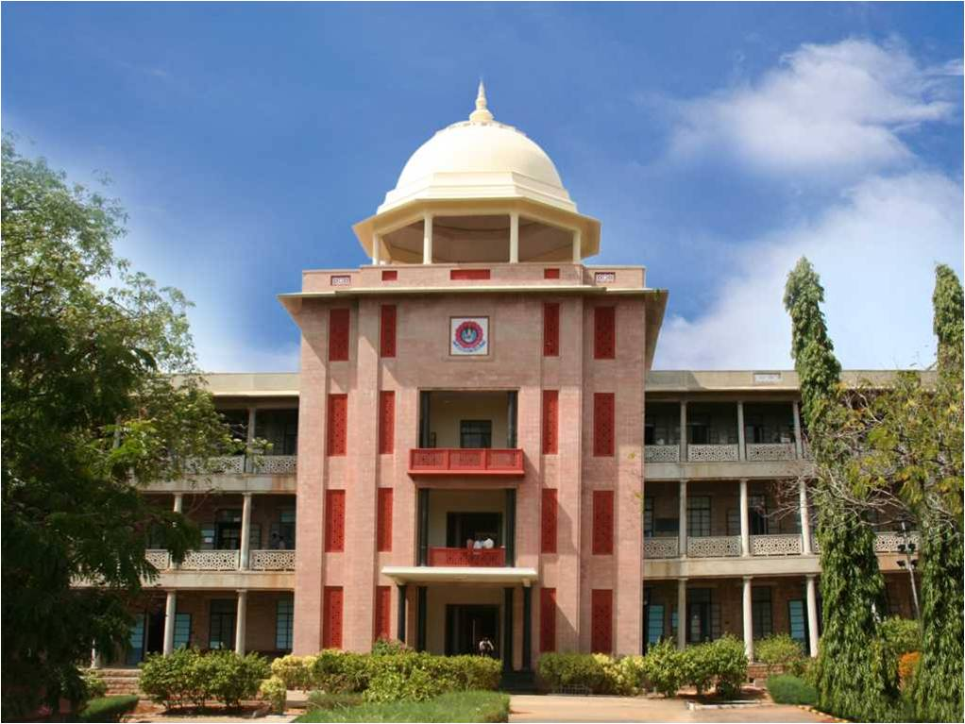
Medicare -AI based Medical Assistant
THIAGARAJAR COLLEGE OF ENGINEERING, MADURAI-15
(A Govt. Aided Autonomous Institution affiliated to Anna University)
- where quality and ethics matter
GIDEON SAMUEL M (2303917724421013)
NITHIN SUNDAR KK (2303917724421036)
SRIKANTH M (2303917724421055)
Guide: Dr. M.K. KAVITHA DEVI (Prof & HOD)
Type of the Project: Product
*
Department of Computer Science and Business Systems
1

Slide 2
Abstract
Medicare is an voice-enabled RAG (Retrieval-Augmented Generation) system that converts spoken medical queries into accurate and reliable responses.
It combines Whisper for high-precision speech-to-text, FAISS for rapid retrieval from curated medical datasets, and an LLM for generating context-aware answers grounded in real data
The system uses a curated medical dataset (symptoms, diseases, treatments, FAQs) stored locally for reliable and private retrieval, ensuring higher accuracy and reduced hallucination compared to standard LLM-only systems.
Demonstrates a complete AI pipeline—speech input → retrieval → generation—showcasing end-to-end multimodal AI integration.

Slide 3
Problem Statement
People often receive inaccurate or generic medical answers from normal AI models because they are not grounded in trusted medical data.
Many users need a voice-based, easy-to-use system to get reliable medical information, especially in urgent situations.
Existing tools do not combine voice input, medical image analysis, and domain-specific knowledge retrieval, making them incomplete for real-world use. Many platforms lack a mechanism like RAG, which ensures answers come from trusted medical datasets instead of model guesswork.
A unified system like Medicare can bridge this gap by offering accessible, trustworthy, and context-rich medical responses.
*
Department of Computer Science and Business Systems
3

Slide 4
Objectives
Develop a voice-enabled medical query system that can understand user speech and convert it into meaningful text for further analysis.
Implement a RAG-based retrieval framework that enhances response accuracy by grounding the system in curated medical datasets.
Integrate multimodal inputs, enabling the system to use both text and image information for improved medical assessment and decision support.
Integrate Image Understanding to support medical image-based queries (rashes, fractures, abnormalities).
Provide Fast, User-Friendly Medical Information Access using voice + image inputs on a single platform.

Slide 5
Module description
Voice Input Module : This module captures the user’s voice and converts it into text, creating a clean query for the system. It acts as the starting point for all user interactions.
Image Input Module : Allows users to upload medical images (X rays, reports, scans) and extracts important text or details using ResNet and Yolo model for further analysis.
Preprocessing Module: The converted text is cleaned and transformed into vector embeddings. This prepares the query for fast and accurate retrieval.
RAG Retrieval Module: The system uses FAISS to search the medical knowledge base and fetch the most relevant information. These retrieved chunks give factual grounding to avoid hallucination
.
LLM Generation Module
Output Module
Knowledge Base Module
*
Department of Computer Science and Business Systems
5

Slide 6
Module description
LLM Generation Module : The LLM combines the user query with the retrieved context to generate a precise, medically reliable answer. This module handles reasoning and response generation.
Output Module : The output module formats the final answer and presents it to the user. It can display the text on-screen and also convert it back into speech for voice-based interaction. This module ensures that the response is delivered clearly and efficiently.
Knowledge Base Module : All medical documents are stored as chunks with embeddings in a FAISS index, forming the system’s core knowledge. The knowledge base includes both locally collected medical documents (symptoms, diseases, prescriptions, treatment notes) and trusted public sources like PubMed articles, ensuring accurate and evidence-based retrieval.
*
Department of Computer Science and Business Systems
6

Slide 7
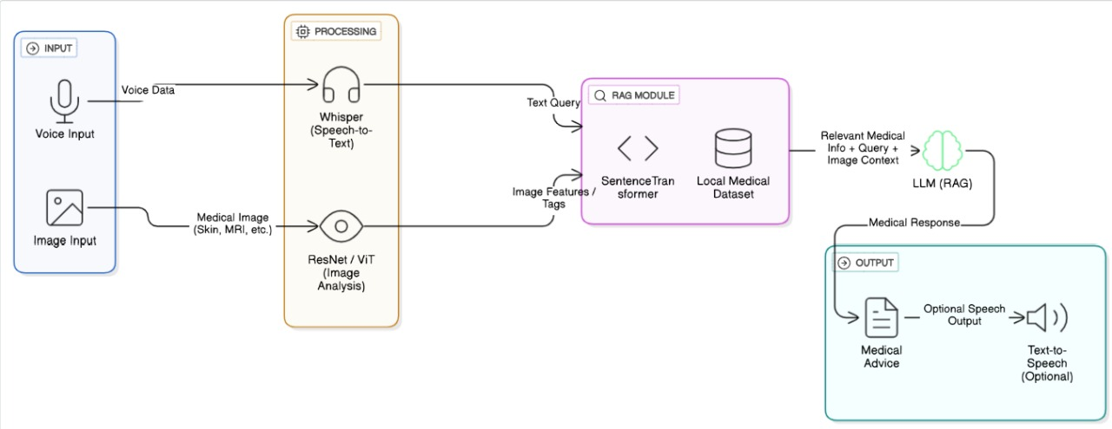
Architecture Diagram
*
Department of Computer Science and Business Systems
7

Slide 8
Tools and Technologies used
SOFTWARES : Python 3.x, PyTorch, NumPy, Pandas, Jupyter Notebook, VS Code, GitHub, Local file system/storage, JSON, CSV, Audio processing libraries, Image processing libraries
TECHNOLOGIES: Retrieval-Augmented Generation (RAG), Large Language Model (LLM), Embedding Model, FAISS Vector Search Engine, Speech-to-Text Model, Image Understanding Model
HARDWARES : Laptop/PC, Microphone
*
Department of Computer Science and Business Systems
8

Slide 9
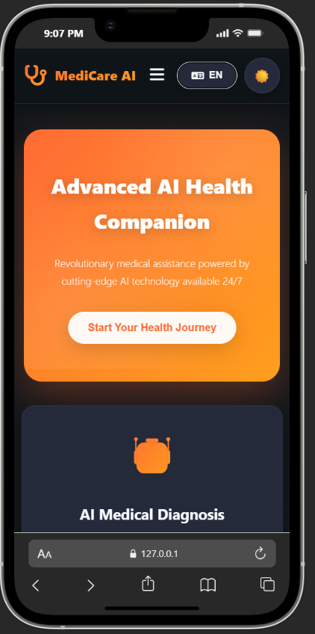
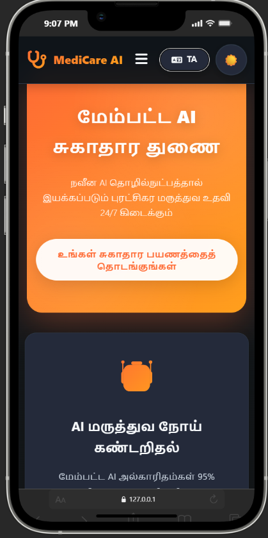
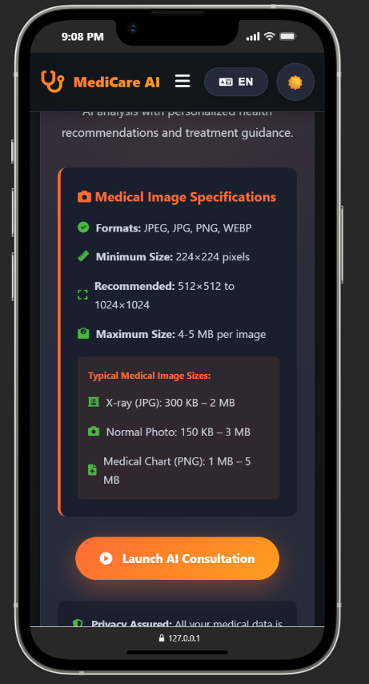
Results and Inference
*
Department of Computer Science and Business Systems
9

Slide 10
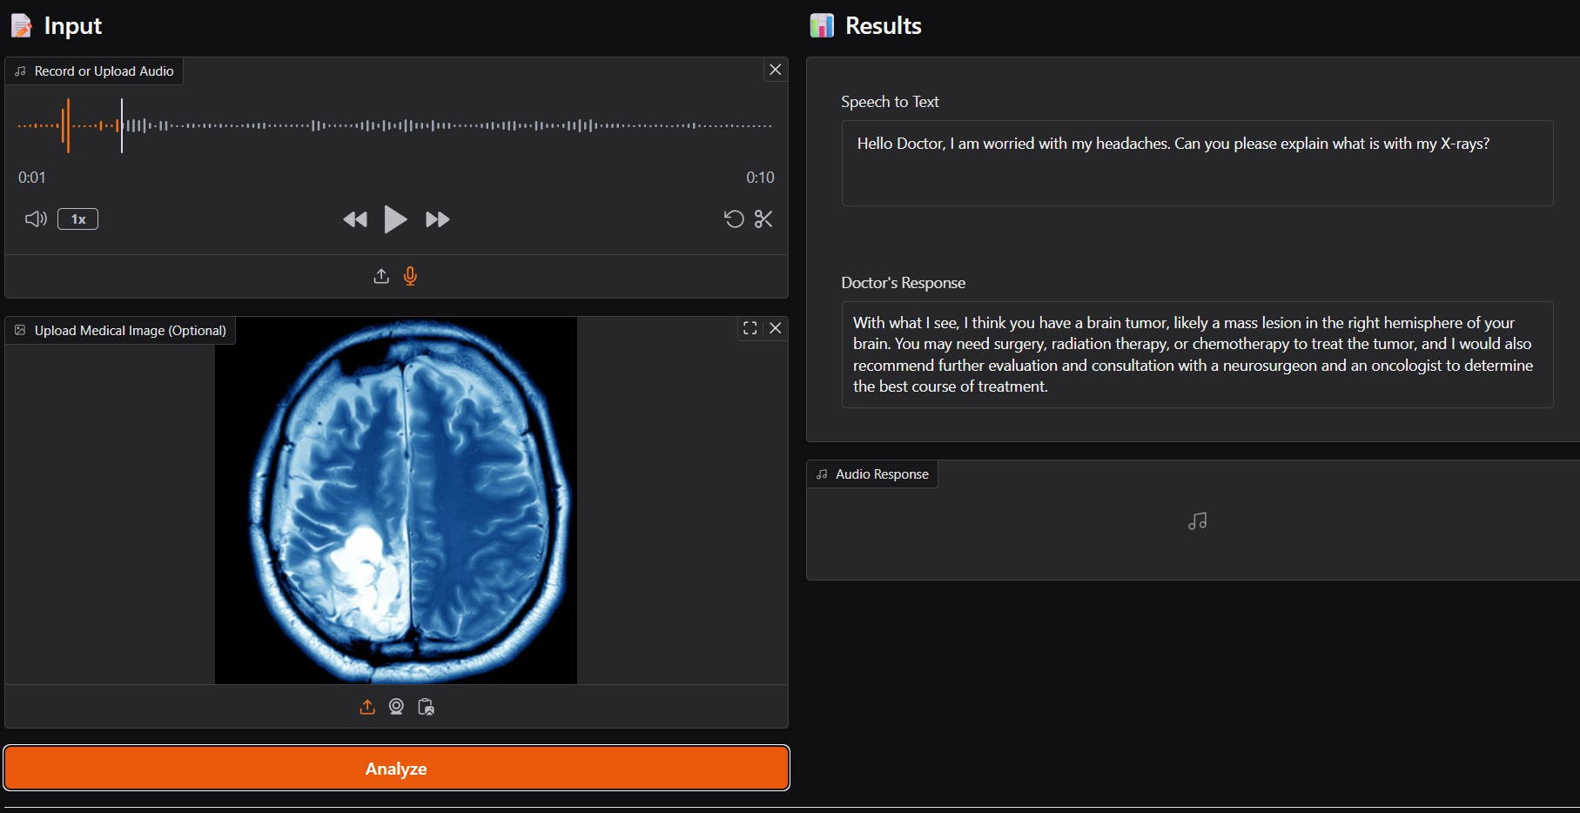
Results and Inference
*
Department of Computer Science and Business Systems
10

Slide 11
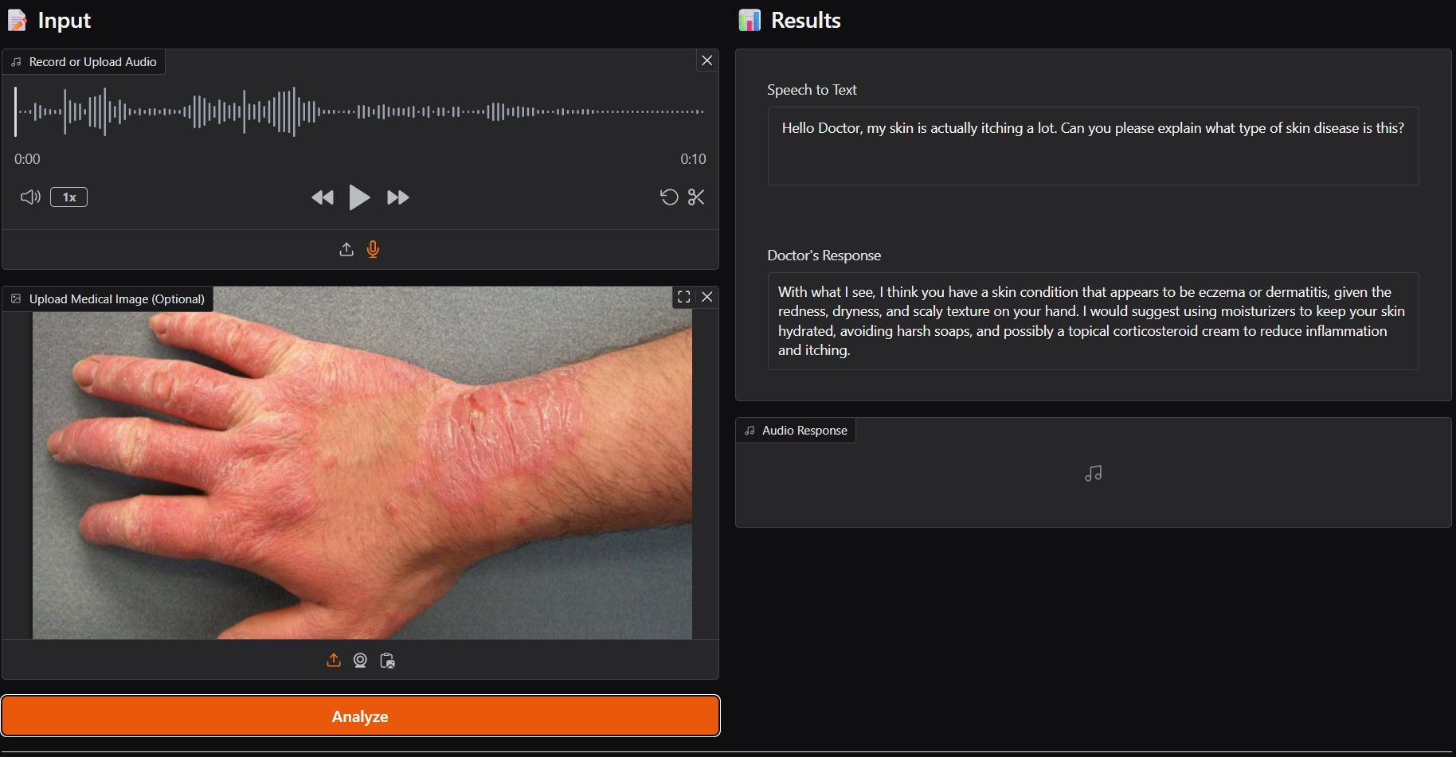
Results and Inference
*
Department of Computer Science and Business Systems
11

Slide 12
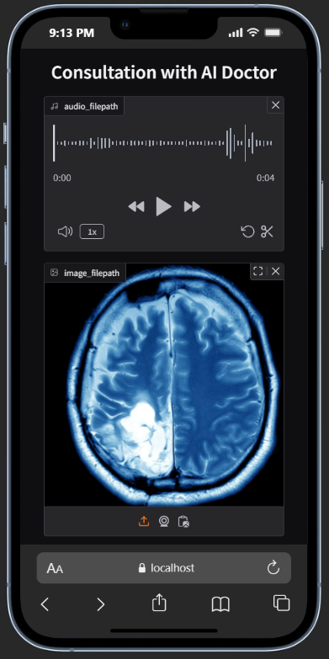
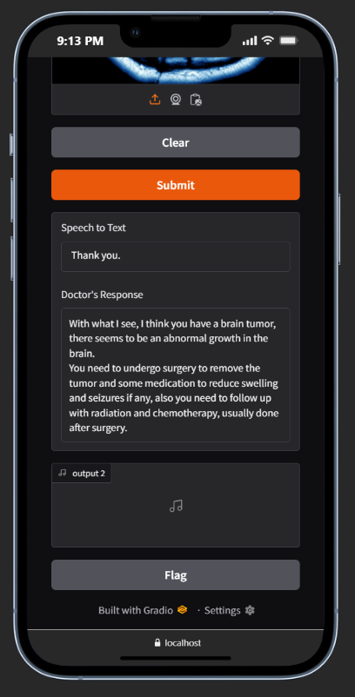
Results and Inference
*
Department of Computer Science and Business Systems
12

Slide 13
Outcomes Achieved
Faster Information Access: FAISS indexing allows quick retrieval from thousands of medical documents.
Improved Accuracy: The RAG-based pipeline delivers significantly higher medical answer accuracy compared to standalone LLMs
Reliable Responses: Answers stay consistent and fact-based because they are grounded in curated local and PubMed medical datasets.
Multi-Modal Capability: The system successfully processes voice, text, and medical images, enabling a complete smart-health assistant.
User-Ready Prototype: A fully functional end-to-end workflow combining speech recognition, retrieval, and generation has been implemented.

Slide 14
Expected Outcome (Publication)
Advanced image-analysis and generation techniques successfully supported a previous study that was accepted at the International Conference on Data Science & Decision Systems (ICDDS 2025)
*
Department of Computer Science and Business Systems
14

Slide 15
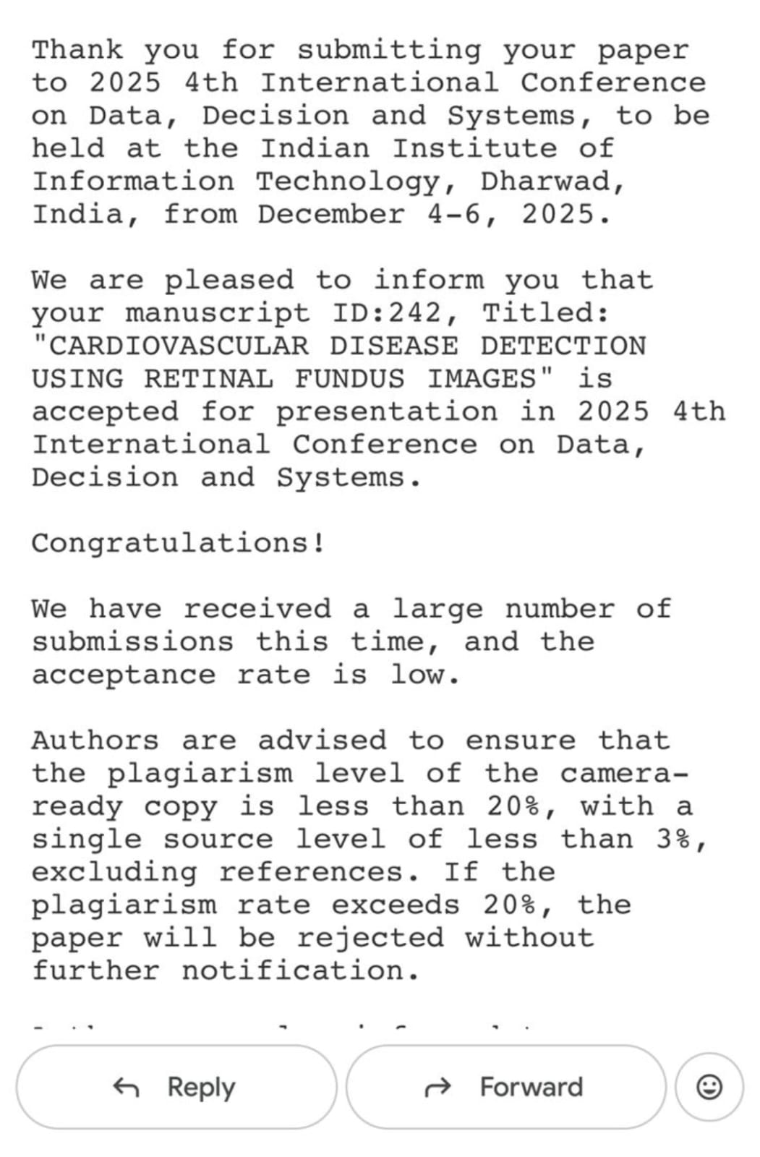
Expected Outcome (Publication)
*
Department of Computer Science and Business Systems
15

Slide 16
Expected Outcome
Similar image-analysis and generation techniques were successfully applied in an earlier study accepted at the IIIT Dharwad Research Conference (December 2025). Building on this foundation, the MediCare system will integrate advanced medical image understanding with a RAG-based retrieval pipeline to further improve diagnostic assistance and response accuracy. The enhanced model is planned for submission to the upcoming IEEE International Conference on Artificial Intelligence in Healthcare (AICHC 2025), scheduled for August 21–23, 2025, providing an opportunity to contribute to emerging developments in AI-driven medical decision-support systems.
*
Department of Computer Science and Business Systems
16

Slide 17
References
Sahoo, A., Pingua, B., Kandpal, M., Murmu, D., Rautaray, J., Barik, R. K., & Saikia, M. J. (2025). Medical LLMs: Fine-Tuning vs. Retrieval-Augmented Generation. Bioengineering, 12(7), 687. https://doi.org/10.3390/bioengineering12070687
Wu, J., Zhu, J., Qi, Y., Chen, J., Xu, M., Menolascina, F., Jin, Y., & Grau, V. (2025). Medical Graph RAG: Evidence-based Medical Large Language Model via Graph Retrieval-Augmented Generation. In Proceedings of the 63rd Annual Meeting of the Association for Computational Linguistics (ACL), 28443–28467. https://doi.org/10.18653/v1/2025.acl-long.138
Chen, Z., Liao, Y., Jiang, S., Zhu, Z., Li, H., Wang, Y., … Jin, Y. (2025). HeteroRAG: A Heterogeneous Retrieval-Augmented Generation Framework for Medical Vision Language Tasks. arXiv. https://arxiv.org/abs/2508.12778
Lewis, P., Perez, E., Piktus, A., Petroni, F., Karpukhin, V., Goyal, N., … Riedel, S. (2020). Retrieval-augmented generation for knowledge-intensive NLP tasks. Advances in Neural Information Processing Systems, 33, 9459–9474. https://arxiv.org/abs/2005.11401
*
Department of Computer Science and Business Systems
17

